Slide 1
Library Management System
Student Name: ROHIL KUMAR DE
Roll Number: 85
Stream : CSE IOT
Course / Subject : OOP

Slide 2
INTRODUCTION
Libraries require efficient management of books and members.
Manual systems are time-consuming and prone to errors.
A digital solution can automate book issuing, returning, and record maintenance.
This project implements a console-based Library Management System using Java and OOP principles.

Slide 3
PROBLEM STATEMENT
Manual record keeping leads to:
Data inconsistencies
Difficulty tracking issued books
Inefficient member management
There is a need for a structured software system to manage books and members efficiently.

Slide 4
OBJECTIVES
Automate library operations.
Maintain records of books and members.
Implement Object-Oriented Programming concepts.
Provide a menu-driven system for user interaction.
Ensure efficient data management using Java collections.

Slide 5
TECHNOLOGIES USED
Java
IntelliJ IDEA / VS Code
Git & GitHub
Java Collections Framework
Exception Handling

Slide 6
SYSTEM ARCHITECTURE
The system is divided into four layers:
Model Layer
Book
Member
StudentMember
FacultyMember
Service Layer
LibraryService
Exception Layer
Custom exceptions
Application Layer
LibraryApp (Main class)

Slide 7
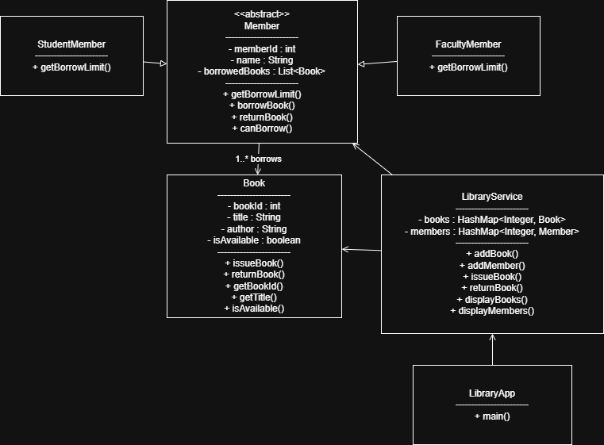
UML CLASS DIAGRAM

Slide 8
OOPS CONCEPTS USED
Abstraction
Abstract class Member.
Inheritance
StudentMember and FacultyMember extend Member.
Polymorphism
getBorrowLimit() overridden in subclasses.
Encapsulation
Private variables with controlled access methods.

Slide 9
DATA STRUCTURES:
HashMap
HashMap<Integer, Book> HashMap<Integer, Member>
Used for fast data retrieval.
ArrayList
List<Book> borrowedBooks
Stores books borrowed by a member.

Slide 10
EXCEPTION HANDLING
Custom exceptions used:
BookNotFoundException
MemberNotFoundException
BookUnavailableException
Purpose:
Prevent invalid operations
Improve program stability
Provide clear error messages

Slide 11
PROGRAM WORKFLOW
User runs the program.
Menu options are displayed.
User selects an operation.
System processes request using LibraryService.
Books and members are stored in collections.
Errors handled using exceptions.

Slide 12
FUTURE IMPROVEMENTS
Add file-based data persistence
Integrate database (MySQL)
Implement graphical user interface (GUI)
Add book search functionality
Implement fine calculation system

Slide 13
CONCLUSION
The project demonstrates practical use of Object-Oriented Programming concepts in Java.
The system automates library operations and improves record management.
Modular design allows future scalability and feature expansion.

